Slide 1


INNOMATICS TECHNOLOGY HUB
A sister concern of

Slide 2

Introduction
to
Statistics

Slide 3


First thoughts on Maths

Slide 4

When am I going to use this?

Slide 5
Early example of Data analytics - WW-II
Statistical Research Group -group of Applied Mathematicians aiding with war effort
Recommendations made on everything - best trajectory of fighter plane to keep enemy aircraft in sight, optimal mixture of ammunition, strategic bombing etc

Slide 6

Aircraft Armor Conundrum
Section of Plane | Bullet Holes per Sq Ft
Engine | 1.1
Fuselage | 1.73
Fuel system | 1.55
Rest of the plane | 1.8

Slide 7
Statistical thinking will one day be as necessary for efficient citizenship as the ability to read and write.
H. G. Wells (1903)

Slide 8
Modern Life..
Abundance of data
Sometimes contradictory evidence
Often, making sense of data is hard
Mathematical sense essential to survive and flourish

Slide 9
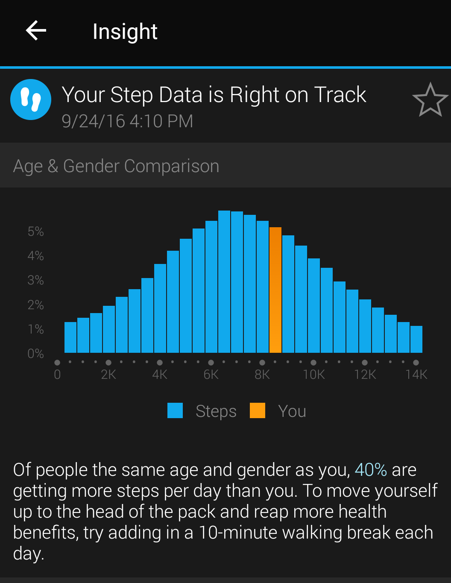
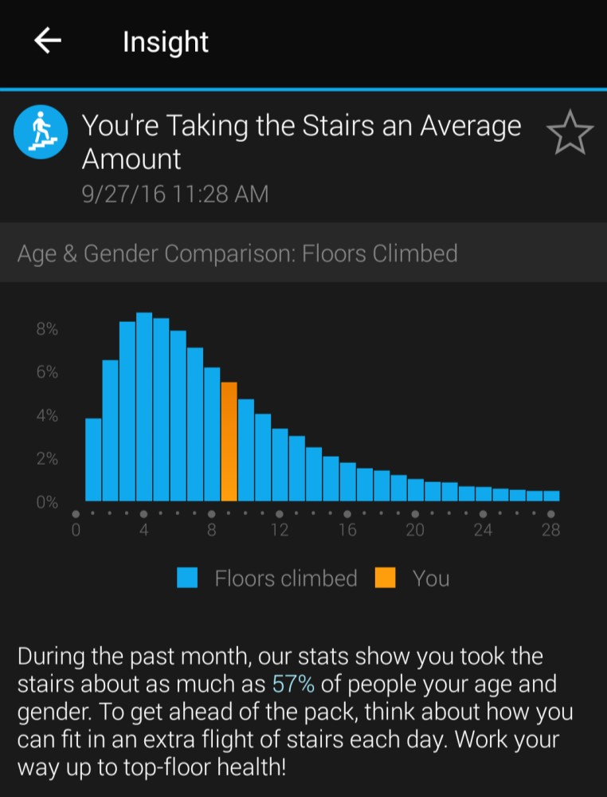
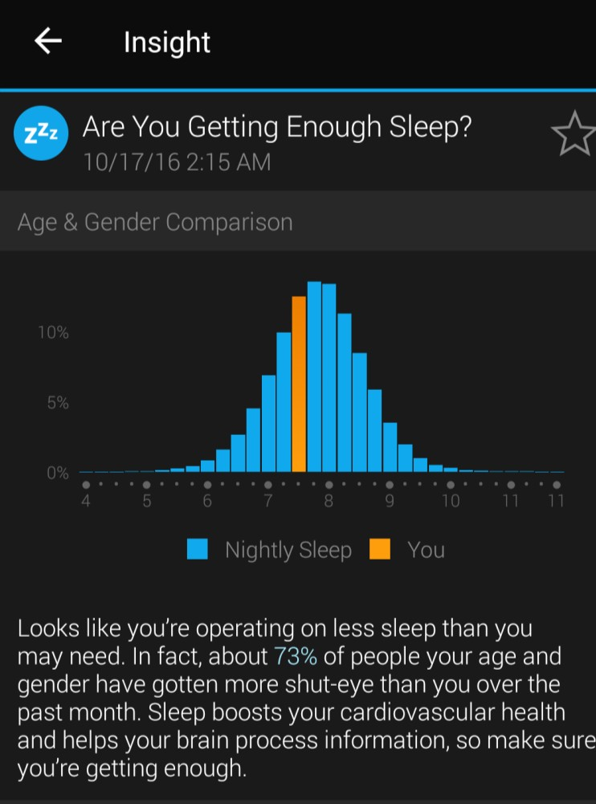
Looking at Data

Slide 10
There are three kinds of lies: lies, damned lies, and statistics.
- Mark Twain / Benjamin Disraeli

Slide 11
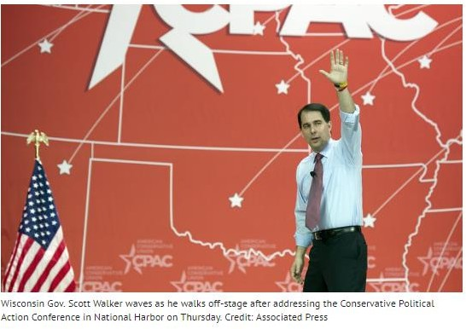

Misleading statistics
http://www.politifact.com/wisconsin/statements/2011/jul/28/republican-party-wisconsin/wisconsin-republican-party-says-more-than-half-nat/

Slide 12
Full Truth
June 2011
US labor dept statistics – 18000 jobs in June
Wisconsin Added 9500 jobs
Wisconsin the fastest growing state in US?
California Added 28800 jobs
Texas 35000 jobs!
Many states lost jobs
Moral:
Do not trust percentages when negative numbers are involved

Slide 13

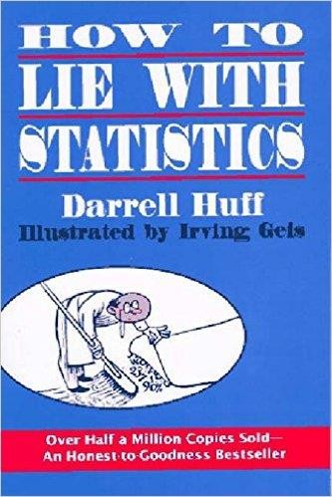

Slide 14

Misusing statistics
A few examples -
Bad samples
How many of you think that Data Science is a promising career choice?
Small samples
“3 out of 4 dentists agree that Colgate is the best toothpaste”
Detached statistics
“Lays chips is 30% more tasty” Compared to what?
Poor definition
How is “30% more tasty” defined/measured?

Slide 15
Misusing statistics
Changing the subject
“During my administration, the expenses increased by a mere 3%”
“My opponent’s administration caused an increased expenditure of 100 crores!”
Semi-attached Figure (Implied connections)
“Waking up early is a good habit. Over 70% of the CEOs of the fortune 500 companies are early risers”
Loaded Questions or Leading Questions
“Do you believe that you should be taxed so other citizens don’t have to work?”
“Do you think that government should help those people who cannot find work?”

Slide 16
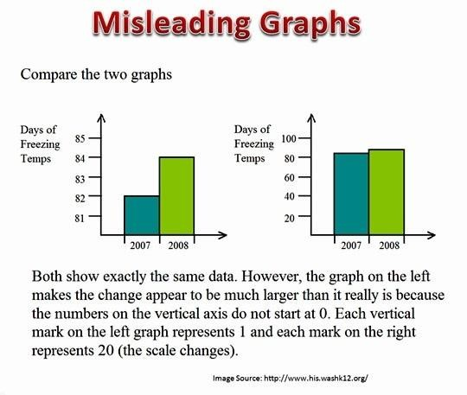

Slide 17
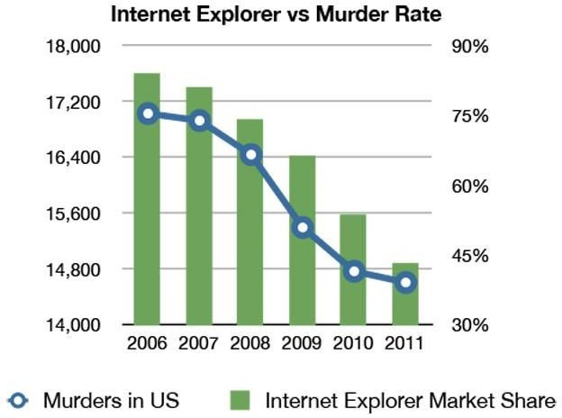
Correlation vs Causation

Slide 18
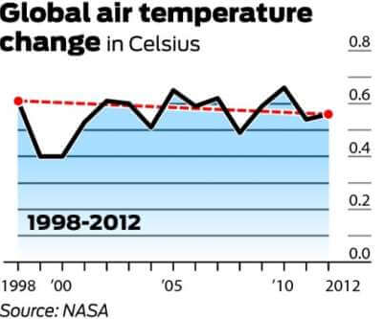
Global Warming: A fake phenomenon
Notes:
https://www.datapine.com/blog/misleading-statistics-and-data/

Slide 19
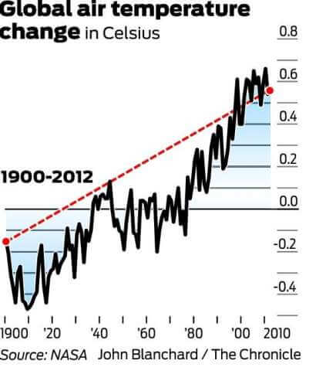
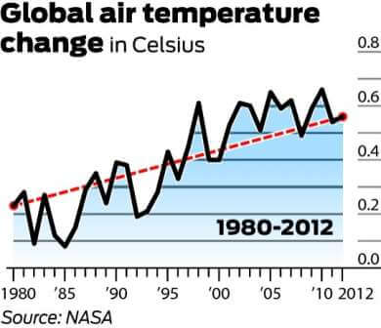
Global Warming: A fake phenomenon

Slide 20
Catching Statistical Errors
Ask these questions:
Who says so?
How do they know?
Watch out for stated & unstated data
Is the sample large enough?
Did somebody change the subject?
Does it make sense?

Slide 21
INNOMATICS TECHNOLOGY HUB
A sister concern of

